Slide 1
Bangladesh Coastal line and Natural Phenomenon
By
Chowdhury Mujaddid Ahmed

Slide 2
Coastal line
The coast is the land along a sea. The boundary of a coast, where land meets water, is called the coastline.
Waves, tides, and currents help create coastlines. When waves crash onto the shore, they wear away at or erode, the land. But they also leave behind little parts of the sea, such as shells, sand dollars, seaweeds, and hermit crabs. Sometimes these objects end up as more permanent parts of the coastline.
Coasts help us understand natural events, such as weather and changing sea levels. During storms, coasts are the first places to be flooded. Some coasts have coastal plains. Coastal plains are pieces of flat, low-lying land that can become visible when sea levels start decreasing.
-Source: National Geography

Slide 3
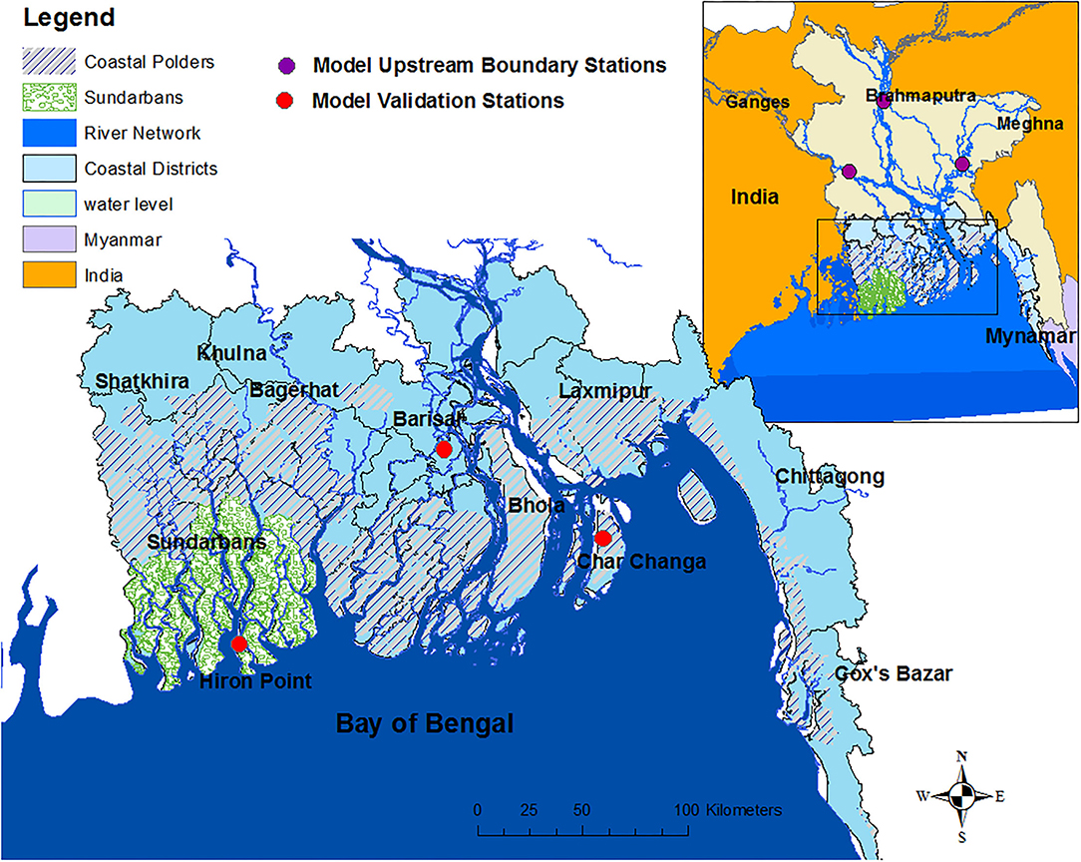
Bangladesh Coastal line
Bangladesh is a small country, the length of the coastline is more than 580 km. The territorial waters of Bangladesh extend 12 nautical miles (22.22 km) and the area of the high seas extending to 200 nautical miles (370.40 km) measured from the base lines constitutes the economic zone of the country.
-Source: Banglapedia

Slide 4
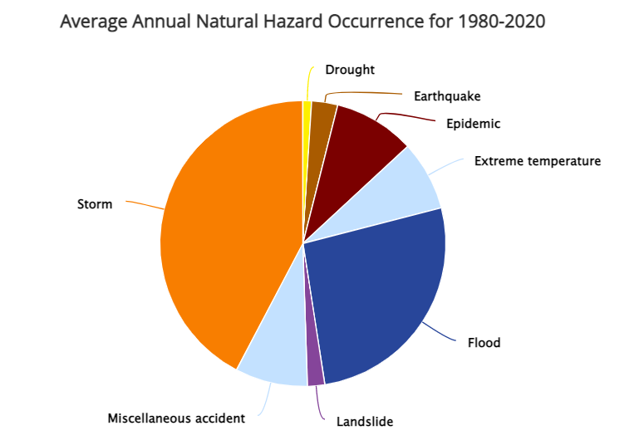
Bangladesh and Natural Phenomena
Earthquakes: Bangladesh is located in a seismically active and high-risk region. The northern and eastern regions of the country are particularly susceptible to earthquakes.
Droughts: Seasonal droughts in Bangladesh most commonly affect the northwestern region, as it receives lower rainfall than the rest of the country. These droughts have a devastating impact on crops thereby also affecting the food security of subsistence farmers.
Floods: Floods and riverbank erosions affect some one million people annually in Bangladesh. Once every three to five years, up to two-thirds of Bangladesh is inundated by floods. Floods affect a greater population base than any other natural hazard in the country.
Cyclones: Sixty percent of the worldwide deaths caused by cyclones in the last 20 years occurred in Bangladesh. The cyclone that struck the coastal areas of Bangladesh in November 1970 caused over 300,000 deaths and US$ 2.5 billion worth of damage to property.
-Source: Climate Change Portal

Slide 5
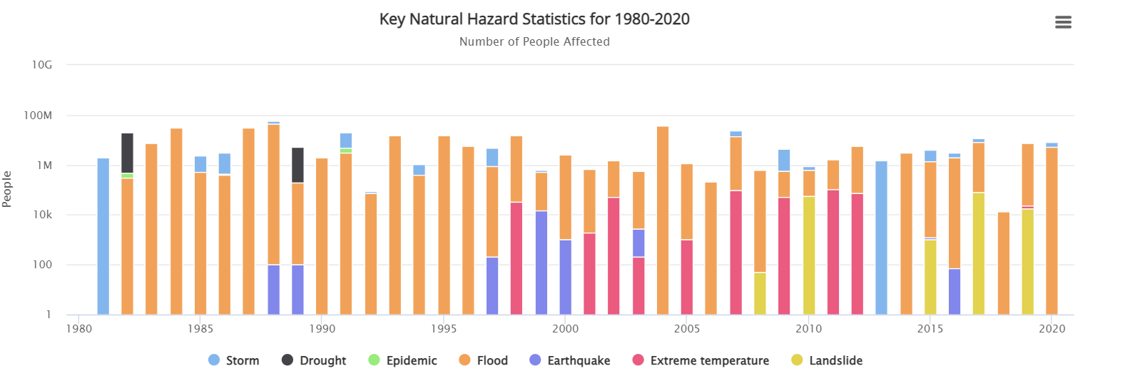
Bangladesh Natural Calamity timeline

Slide 6
Thank you
End of Lecture 4

